Slide 1

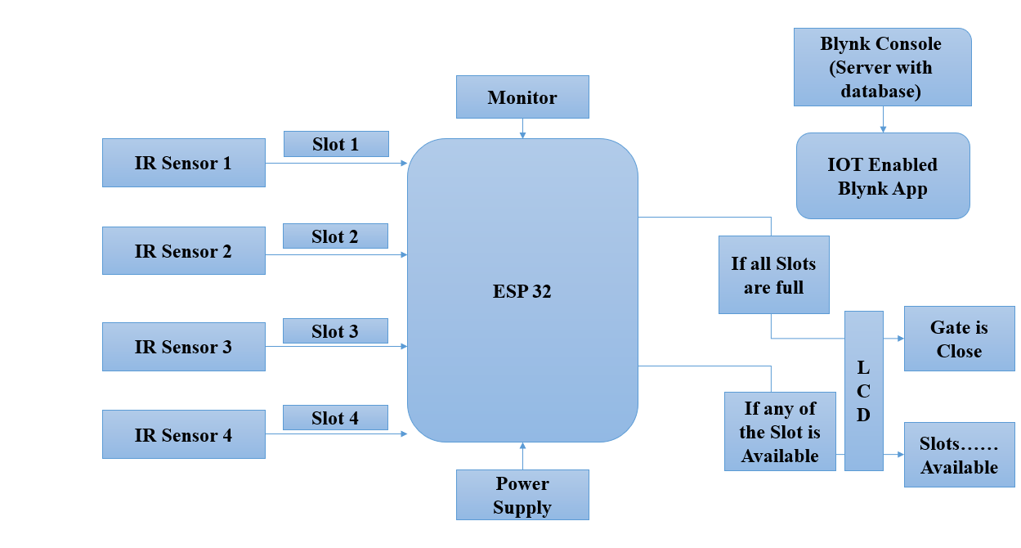
Intelligence Vehicle Parking System
Guide name: Prof. Shweta K
Problem Statement : Design and implement a robust vehicle presence detection system using ESP32 Microcontroller Board for controlling entry barriers in car parking lots.
Block Diagram:
Introduction: The system uses an ESP32 microcontroller, an IR sensor, and a servo motor to manage a barrier arm for parking spaces. The IR sensor detects a car's presence, signaling the ESP32 to open the barrier arm via the servo motor. When the car leaves, the IR sensor signals the ESP32 to close the barrier arm. The ESP32 is connected to an Arduino Cloud account for remote management.
Specification Table:
Sl. No. | Requirements | Objective | Specification
 |  |  | Hardware | Software | Sensors | Actuators | Communication Protocol
1. | ESP 32 | The ESP32 is used in this project for its capability to control the servo motor and communicate with the Arduino Cloud for remote management. | I2C, GPIO | Arduino IDE
2. | I2C | I2C is used to facilitate communication between the ESP32 microcontroller and peripherals like the IR sensor and servo motor in this project. |  |  |  |  | Transfer rates up to 400 kbit/s.
3. | 16x2 LCD | The 16x2 LCD is used to display status information and feedback messages in real-time for user interaction and system monitoring. | Display Device
4. | Servo Motor | The servo motor is used to mechanically control the opening and closing of the barrier arm in response to the IR sensor detecting the presence of a car. |  |  |  | To Open and close the Gate..
5. | IR Sensors | IR sensors are used to detect the presence of a car approaching or leaving the parking space. |  |  | HC-SR501 |  | SPI
Drivable
Results: Parking barrier system where a car's presence detected by an IR sensor triggers a servo motor-controlled barrier arm to open and close, managed through an ESP32 and monitored via Arduino Cloud integration for remote access and data logging.

